Slide 1
Digital Communication 24EC2208
Pulse Modulation Systems

Slide 2
Outlines
Introduction
PAM
PWM
PPM
Comparison

Slide 3
Introduction
AM, FM and PM : Continuous Carrier wave,
Frequency translation.
Pulse Modulation: Pulse carrier wave, short distance.
Pulse Modulated waves are rich in d.c and low frequency components.
Direct transmission of Pulse modulated signal is very difficult.

Slide 4
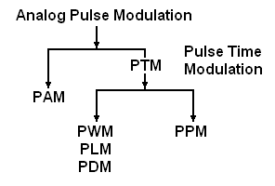

Slide 5
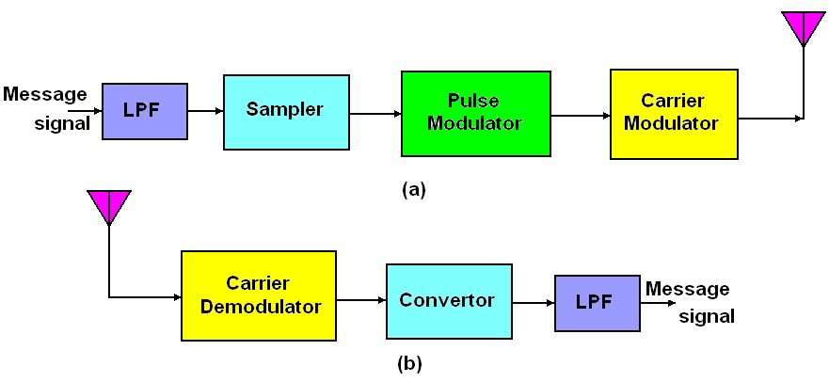

Slide 6
Pulse Amplitude Modulation

Slide 7
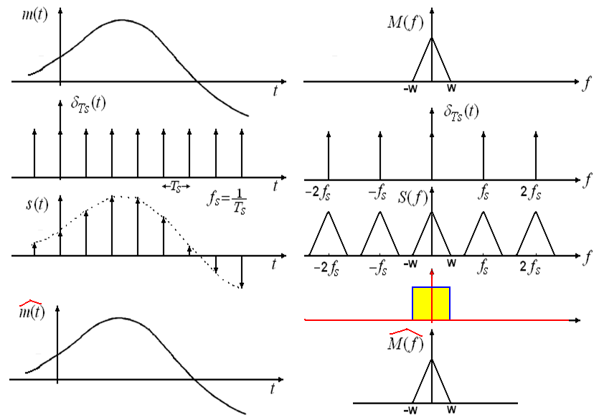
Sampling Process

Slide 8
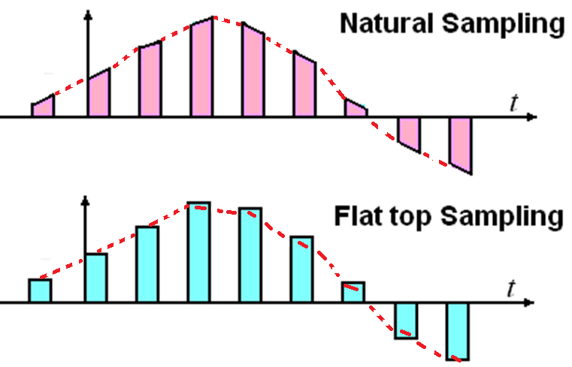

Slide 9

Pulse Amplitude Modulation
PAM may be defined as the type of modulation in which the amplitudes of regularly spaced rectangular pulses vary according to the instantaneous value of the modulating signal.
The pulses of PAM signal may be flat type or natural type.
PAM is two step process.
Instantaneous
Sampling
2. Lengthening

Slide 10
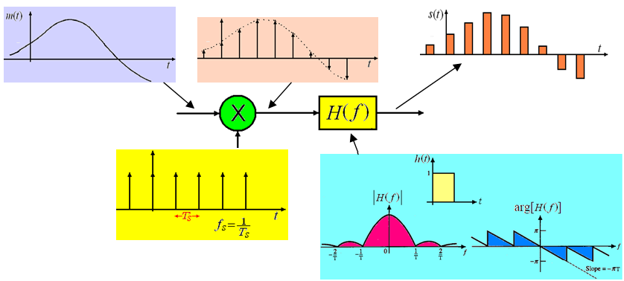
Instantaneous
Sampling
2. Lengthening

Slide 11
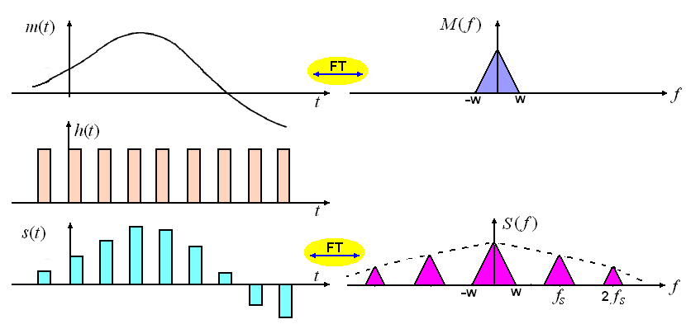
PAM Generation

Slide 12
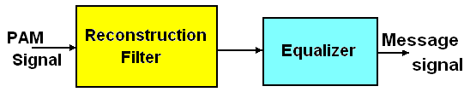
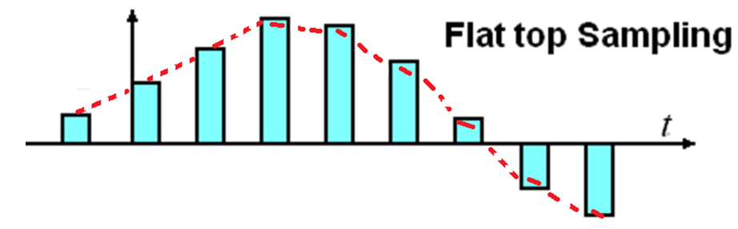



PAM Demodulation
Reconstruction Filter: LPF
Equalizer: Compensate for magnitude distortion and phase delay

Slide 13
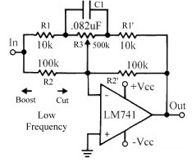
Equalizer
The equalizer has the effect of decreasing the in-band loss of the reconstruction filter as the frequency increases in such a manner as to compensate for the aperture effect.
Designed with acoustics in mind, to “equalize” all of the sound frequencies.

Slide 14
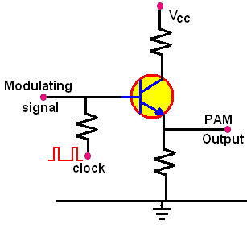
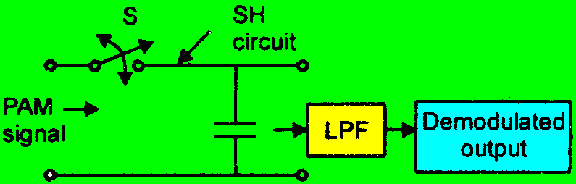

Slide 15
Advantages of PAM
It is the base for all digital modulation techniques and it is simple process for both modulation and demodulation technique.
No complex circuitry is required for both transmission and reception. Transmitter and receiver circuitry is simple and easy to construct.
PAM can generate other pulse modulation signals and can carry the message or information at same time.

Slide 16
Dis-advantages of PAM
Bandwidth is high.
Since the noise affects the amplitude of the waveform, like AM, PAM is also less immune to noise.
PAM waveform has pulses with varying amplitude and therefore power required to transmit them is not constant. This requires that the transmitter must be able to handle the power required to transmit pulse having maximum amplitude.

Slide 17
Sample and Hold

Slide 18
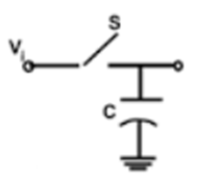
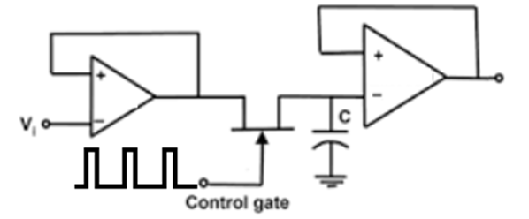
The sample and hold circuit generates the samples of the analogue input signal and holds the latest sampled values for definite time and reflects it at the output.

Slide 19
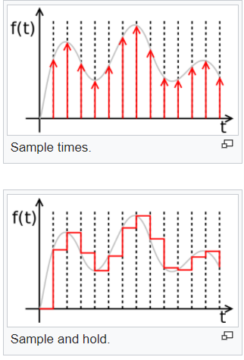

Slide 20
Application of Sample and Hold Circuit
Data Distribution System
Sampling Oscilloscopes
Data Conversion System
Digital Voltmeters
Analog Signal Processing
Signal Constructional Filters

Slide 21
Pulse Time Modulation

Slide 22
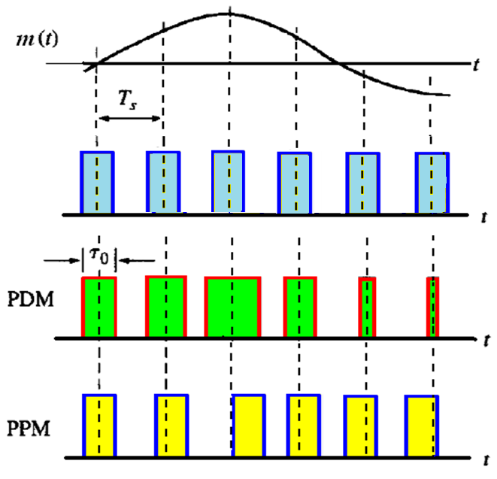
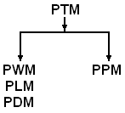
Pulse Time Modulation

Slide 23
Pulse Width Modulation Pulse Duration Modulation Pulse Length Modulation

Slide 24

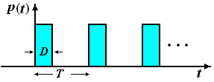
Pulse Train

Slide 25
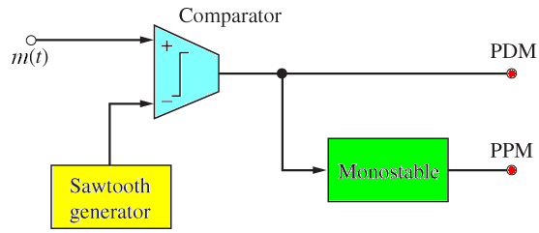
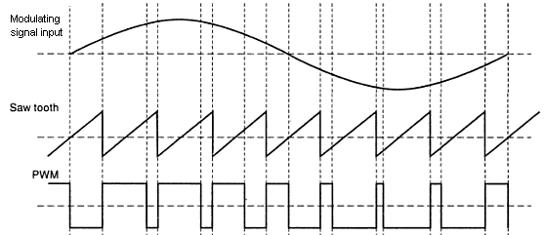
Pulse Width Modulation
In PWM, the width of the carrier pulses is varied in accordance with the modulating signal
Direct Method

Slide 26
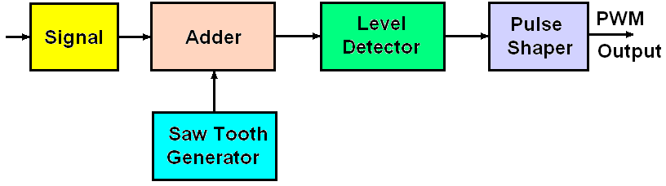
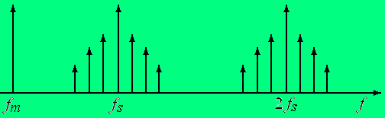
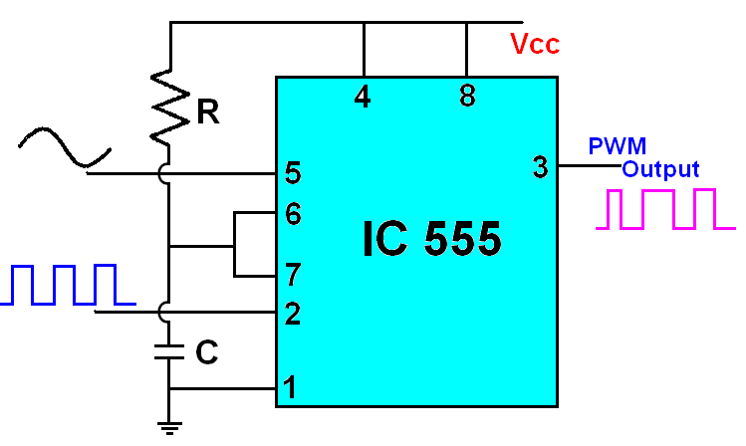
Indirect Method of PWM
Spectrum of PWM

Slide 27
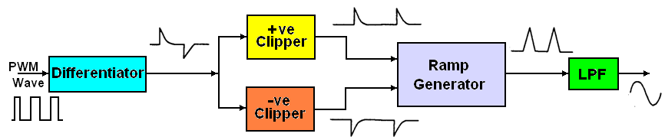
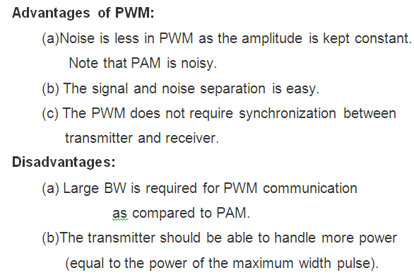
Demodulation of PWM

Slide 28
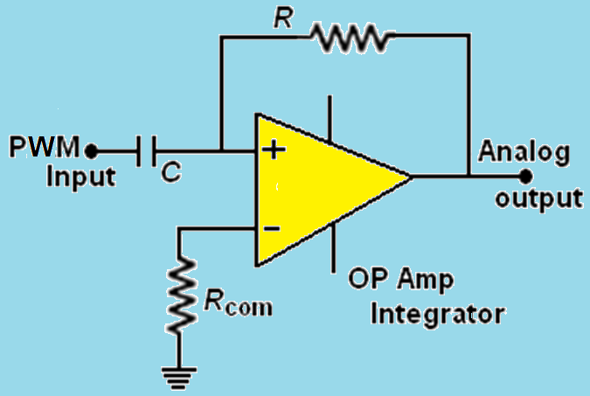
PWM Demodulator

Slide 29
Pulse Position Modulation (PPM)

Slide 30
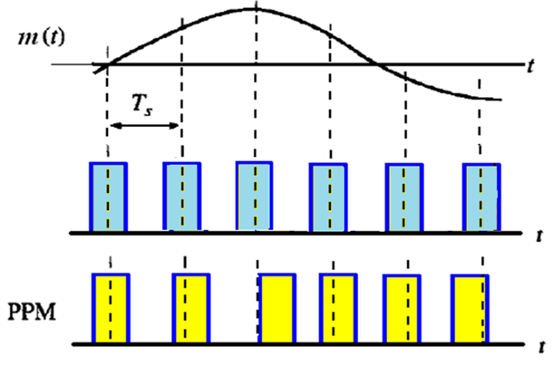
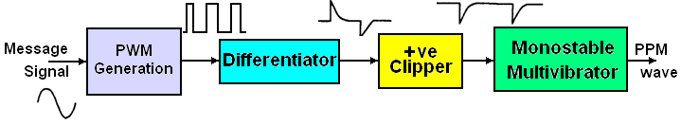
PPM

Slide 31
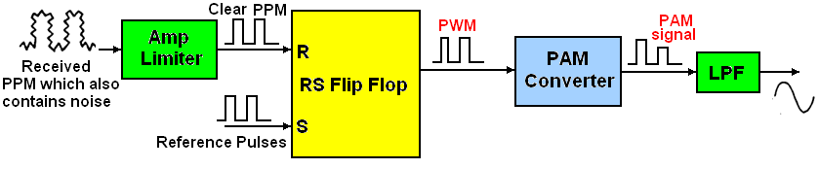
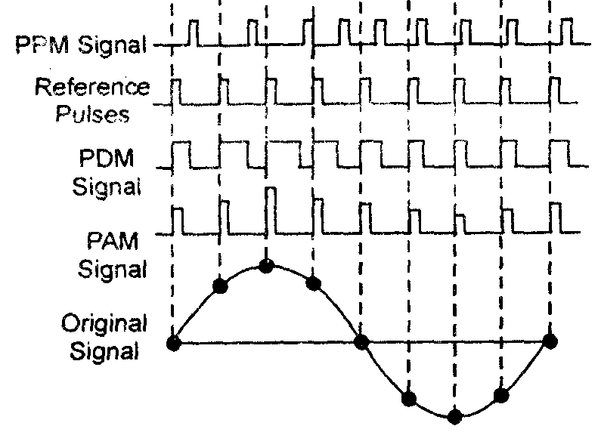
PPM Demodulation

Slide 32
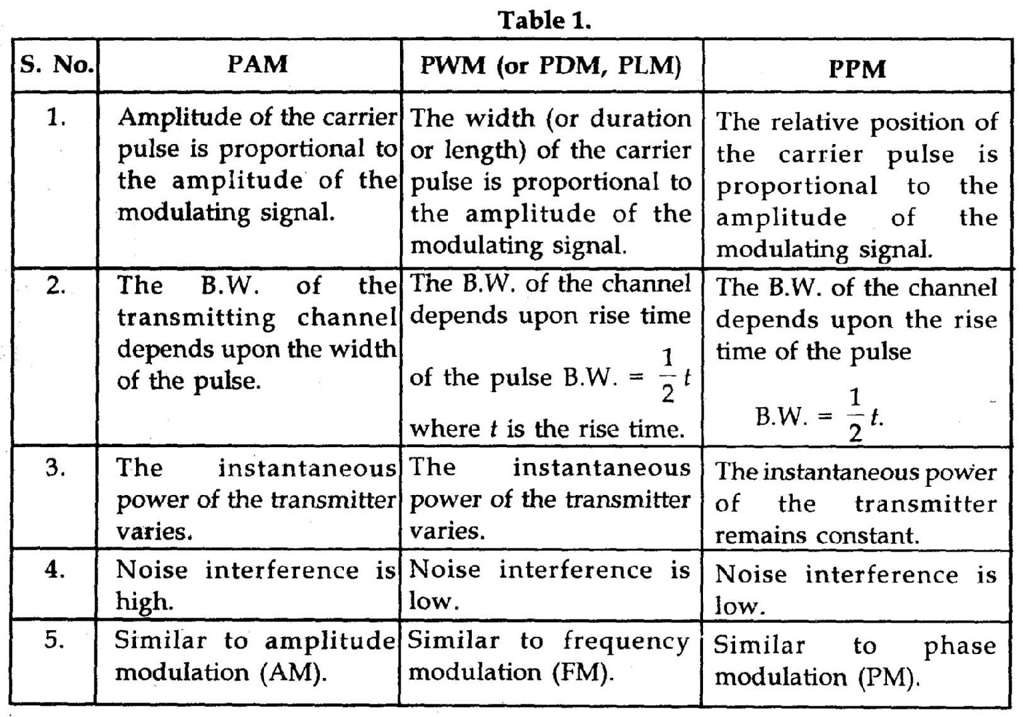
Comparison

Slide 33
End

